Slide 1
Current status of robot case

Slide 2
Data
The data is currently lacking:
Data that is available:
Oktober 2020 till November 2020
1st of March 2021
May 2021 till Juli 2021
Oktober 2021 till March 2022
This is about 33 data points, i.e. 8 months of data, whereof 5 months continuously.

Slide 3
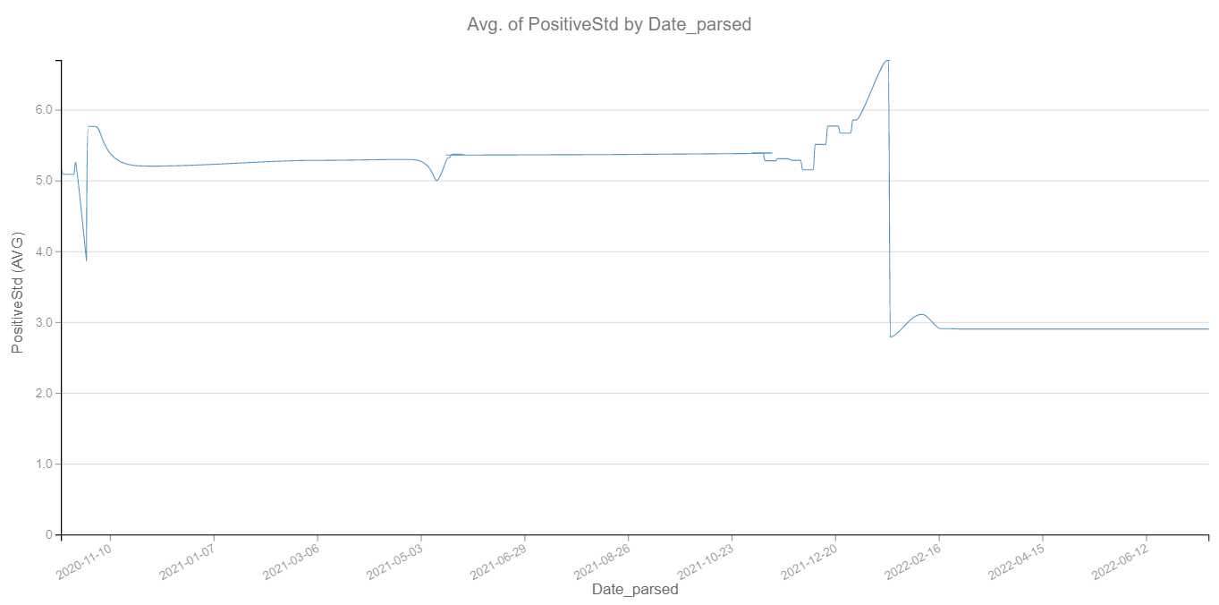
Prediction of Failure
Prediction of failure of robot 6640-101814 at

Slide 4
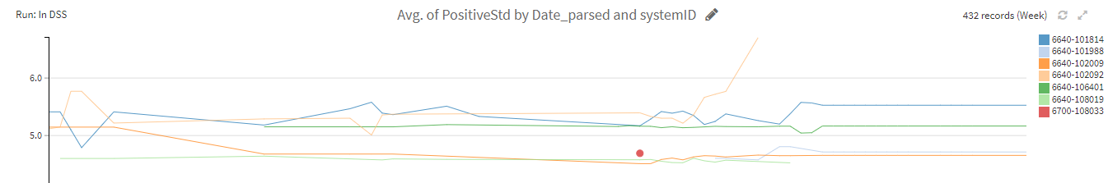
Prediction of High Risk
For example threshold 4.5, finds 7 gearboxes, of which:
6640-102092 -> Downtime, Januari 2022
6640-101988 -> Just in time replacement, Juli 2022
6640-101814 -> Downtime, August 2022

Slide 5
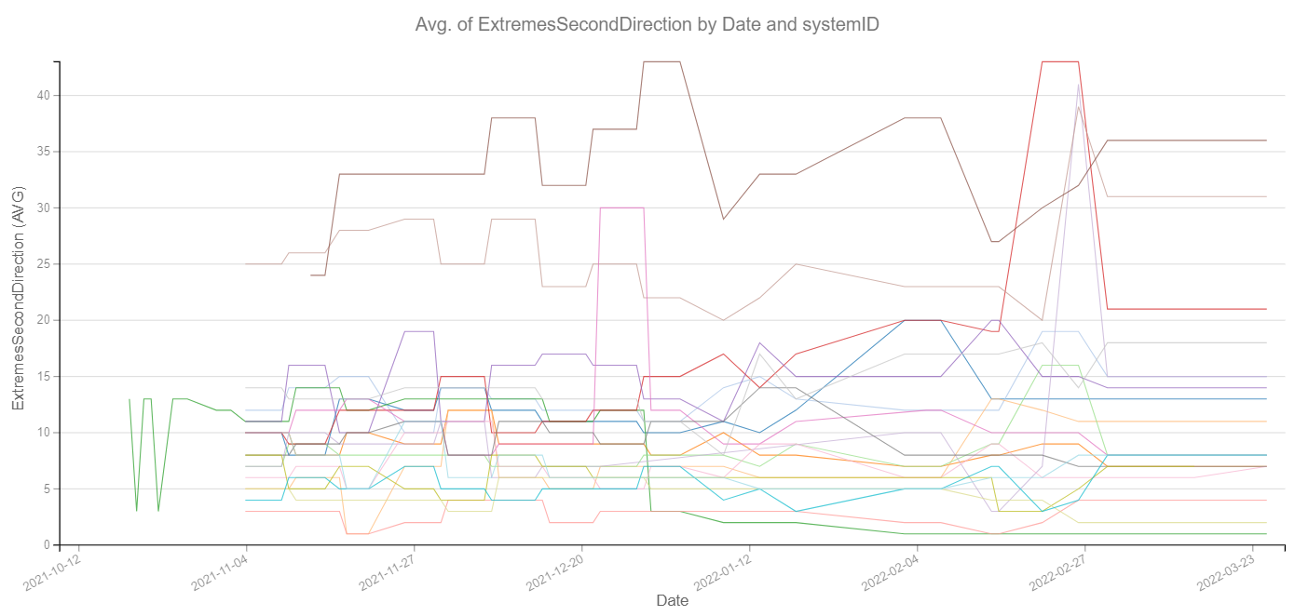
Current analysis of the tracks are insufficient
Current analysis show the worst offenders are
6640-102009
6640-102008
6640-101875
However, these have had no maintenance done in 2022, one of them having no comments from yearly measurements.

Slide 6
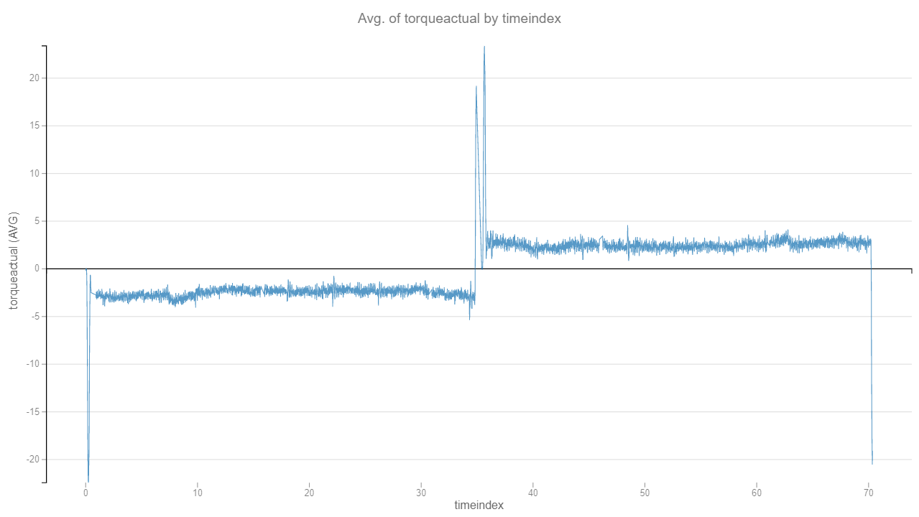
Current analysis of the tracks are insufficient
Tracks test:
Id: 6640-102009
Date: March 2022

Slide 7
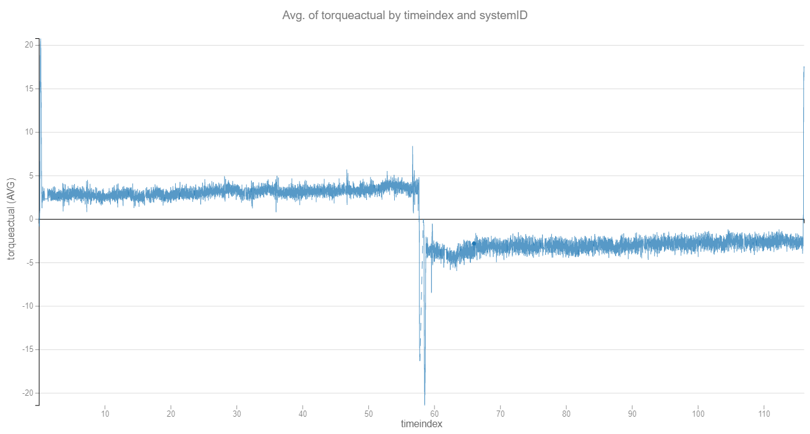
Current analysis of the tracks are insufficient
Tracks test:
Id: 6640-102008
Date: March 2022

Slide 8
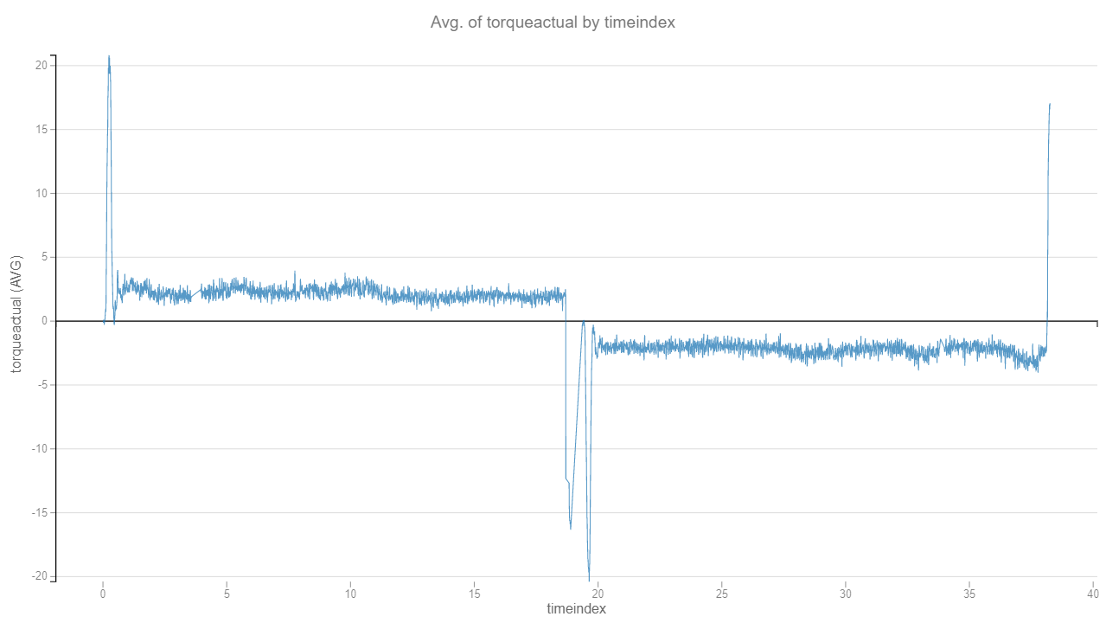
Current analysis of the tracks are insufficient
Tracks test:
Id: 6640-101875
Date: March 2022

Slide 9
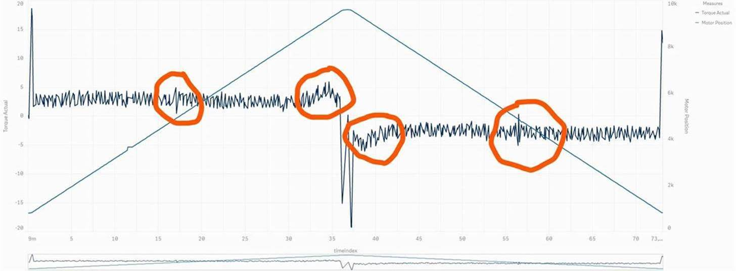
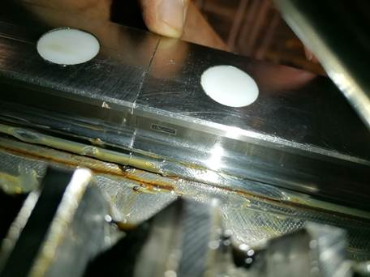
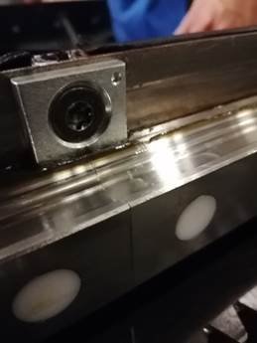
Track faults are predictable
We have seen before that tracks are being able to be predicted

Slide 10
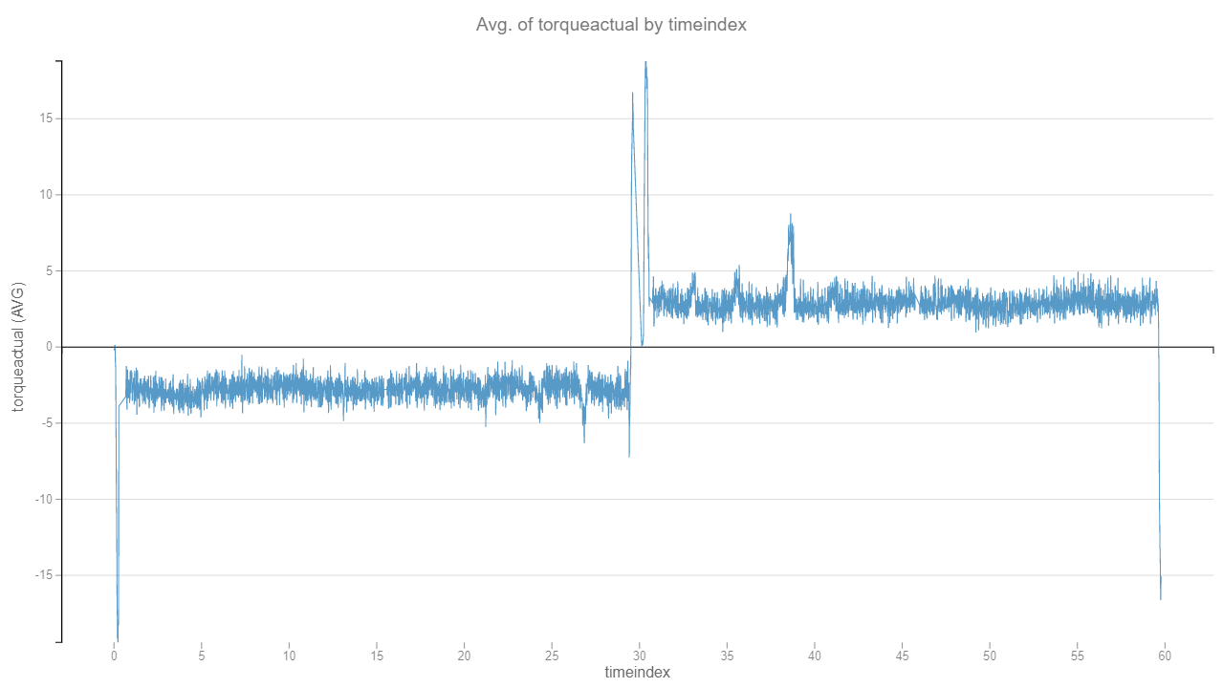
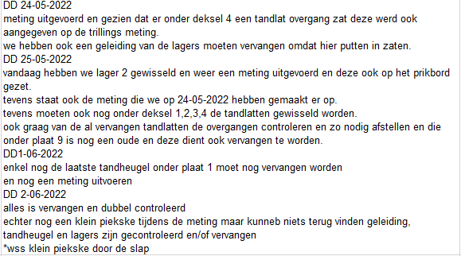
Track faults are predictable
And we can see this in the historical data as well.
Example 6640-1020 in around March 2022.

Slide 11
What is next?
Short-term:
A colour system showing which motors are high risk or not
A pilot warning system which will warn that a motor is failing
Medium-term:
Analytics for the rails, including it in the warning system
Long-term:
Expanding the warning system to more subsystems (all axis, oil, etc.)
Explainable warning system

